Slide 1
Project Implementation, Closure, and Evaluation

Slide 2
Learning Objectives
Describe the three tactical approaches to information implementation and installation: (1) direct cutover (2) parallel (3) phased. Compare the advantages and disadvantages of each approach.
Describe the processes associated with project closure to ensure that the project is closed in an orderly manner.
Identify the four different project evaluations or reviews: (1) individual performance review (2) postmortem review (3) project audit (4) evaluation of the project’s MOV.

Slide 3
Project Implementation
Focuses on installing or delivering the project’s major deliverable – eg, the information system that was built or purchased
For IT projects, three general tactical implementation plans:
  Direct cutover
  Parallel
  Phased

Slide 4
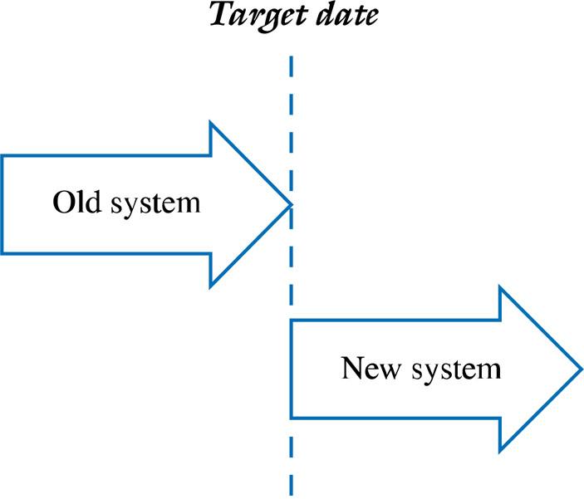
Direct Cutover

Slide 5
Direct Cutover
Old system is shut down and new turned on
May be appropriate when:
  Quick delivery critical
  Old system so poor it must be replaced ASAP
  System not mission critical – failure may not have a major impact on the organisation
Risks associated with direct cutover:
  Not always painless – like walking a tightrope without a safety net.
  May result in major delays, frustrated users, lost revenues, and missed deadlines
  Places more pressure and stress on project team

Slide 6
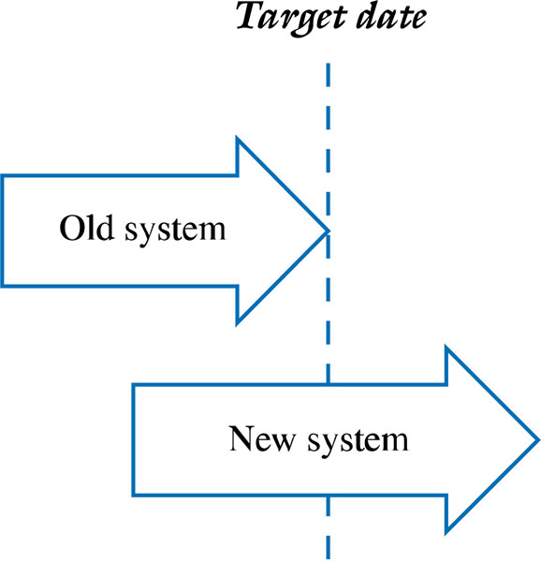
Parallel

Slide 7
Parallel
Old and new systems run concurrently for a time
May be appropriate when problems or the failure of the system can have a major impact on the organization
Provides a safety net or backup in case of problems
Can increase confidence in the new system
Takes longer and requires more resources than direct
Places more pressure on the users – extra workload

Slide 8
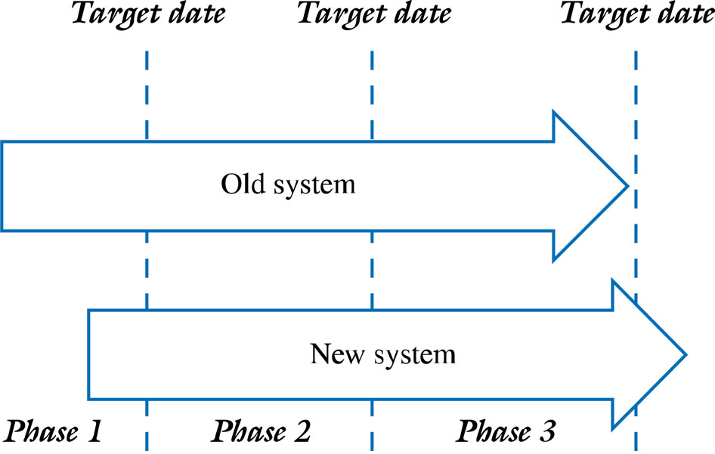
Phased

Slide 9
Phased
System is introduced in modules or in different parts of the organization incrementally
Allows for an organized and managed approach for implementing system modules or a system/upgrades in different departments or geographical locations
Experience with early implementation can guide and make later implementations go more smoothly
Takes longer and may cost more than the direct cutover approach
May be less risky and much more manageable
Problems encountered during early phases can impact the overall implementation schedule

Slide 10
Administrative Closure
Normal – as planned
Premature – early even if not complete
Perpetual – runaway, never ending
Failed – unsuccessful – cost of completion outweigh the benefits
Changed Priority – due to resource constraints, misjudged value, needs changes, “starvation”

Slide 11
Realities of Project Closure
Team members are concerned about future jobs
Bugs still exist
Resources are running out
Documentation becomes important
Promised delivery dates may not be met
The players may possess a sense of panic, dimming the chances of an orderly close out.

Slide 12
Important at closure:
The Project Sponsor Acceptance
Shortsighted vs. Knowledgeable Sponsors
Likelihood of acceptance improved when:
  Acceptance criteria clearly defined in the early stages of project
  Completion of all project deliverables and milestones thoroughly documented

Slide 13
From an administrative view, closure allows
for all loose ends to be tied up. From a
psychological perspective, it provides all
of the project stakeholders with a sense
that the project was under control from
the beginning through to its end.

Slide 14
Administrative Closure
The Final Project Report - includes
  Project Summary – description, MOV, scope, schedule, budget and quality objectives
  Comparison of Planned versus Actual – scope, schedule, budget, test plans and test results
  Outstanding Issues
  Project Documentation List – system documentation, user manuals, training materials, maintenance documentation

Slide 15
Administrative Closure
The Final Meeting and Presentation
  Communicates that the project is over
  Formally transfers the system from the team to the organization
  Acknowledge contributions
  Formal signoff

Slide 16
Administrative Closure
Closing the Project – requirements include:
  Verifying that all deliverables and open items are complete.
  Verifying the project sponsor or customer’s formal acceptance of the project.
  Organizing and archiving all project deliverables and documentation.
  Planning for the release of all project resources (i.e., project team members, technology, equipment, facilities, etc.).
  Planning for the evaluations and reviews of the project team members and the project itself.
  Closing of all project accounts.
  Planning a celebration to mark the end of a (successful) project.

Slide 17
Project Evaluation
Individual Performance Review
  Begin with the individual evaluating his/her performance.
  Avoid “why can’t you be more like….?”
  Focus on specific behaviors, not the individual.
  Be consistent and fair.
  Reviews should provide a consensus on improving performance.

Slide 18
Project Evaluation
Postmortem Review – Between Project Manager and Project Team
  Review the initial project’s MOV.
  Review the project scope, schedule, budget, and quality objectives.
  Review each of the project deliverables.
  Review the various project plans and Project Management Body of Knowledge (PMBOK) areas.
  Review the project team performance.

Slide 19
Project Evaluation
Project Audit
  Preferably performed by an outside Auditor who should:
    Have no direct involvement or interest in project.
    Be respected and viewed as impartial and fair.
    Be willing to listen.
    Present no fear of recrimination from special interests.
    Act in the organization’s best interest.
    Have broad base of project and/or industry experience.

Slide 20
Project Evaluation
Evaluating Project Success – The MOV
  Did the project achieve its MOV?
  Was the sponsor/customer satisfied?
  Was the project managed well?
  Did the project manager and team act in a professional and ethical manner?
  What was done right?
  What can we do better next time?

